Slide 1
GSBA 511: Managerial Economics
Prof. Akbulut
Chapter 13 & 14

Slide 2
Monopolistic Competition
Monopolistic competition Market in which firms can enter freely, each producing its own brand or version of a differentiated product.
no or very low barriers to entry
many buyers and many sellers
differentiated products that are highly substitutable but not perfect substitutes

Slide 3
Demand Function facing a Monopolistically Competitive Firm
Firm’s product is differentiated, there may be close but not perfect substitutes.
If the firm lowers its price a little, it will not steal all customers from competitors.
If the firm raises its price a little, it will not lose all its customers to other firms.
The monopolistically competitive firm will face a negatively-sloped, relatively elastic demand curve.

Slide 4
Representative firm in monopolistic competition could earn profit in the short run.
P
MC
ATC
P
Short-run profit
MR = MC
Q
Q
D
MR

Slide 5
Long-Run Equilibrium in Monopolistic Competition
P
“Excess capacity”
MC
LRAC
In long-run equilibrium, firms earn zero profit, produce at less than “capacity,” and create deadweight loss because P>MC.
P
Deadweight loss
Q
Q
MR
D

Slide 6
Perfect Competition and Efficiency
Productive efficiency Situation in which a good or service is produced at the lowest possible cost.
Allocative efficiency A state of the economy in which firms produce up to the point where the last unit provides a marginal benefit to consumers equal to the marginal cost of producing it.

Slide 7
Comparing Monopolistic Competition & Perfect Competition
P
P
MC
LRAC
MC
LRAC
P
P
MR≡ P ≡ demand
Q
Q
Q
D
Q
MR
Under monopolistic competition, P>MC. Thus there is a DWL. The demand curve is downward-sloping, so the zero-profit point is to the left of the point of min AC.
Any gains of monopolistic competition to consumers?

Slide 8
Active Learning
Advertising
So far, we have studied three market structures: perfect competition, monopoly, and monopolistic competition.
In each of these, would you expect to see firms spending money to advertise their products?
Why or why not?
Where would you see most of the advertising?

Slide 9
What makes a firm successful?
Value created relative to competitors due to firm’s ability to
differentiate its product
produce it at a lower average cost than competing firms

Slide 10
Comparing Perfect & Monopolistic Competition
Perfect competition
Monopolistic competition
number of sellers
many
many
free entry/exit
yes
yes
long-run econ. profits
zero
zero
the products firms sell
identical
differentiated
firm has market power?
none, price-taker
yes
D curve facing firm
horizontal
downward-sloping

Slide 11
Oligopoly
In oligopolistic markets, the products may or may not be differentiated.
Only a few firms account for most or all of total production.
Some or all firms earn substantial profits over the long run because barriers to entry make it difficult or impossible for new firms to enter.
Examples: automobiles, steel, aluminum, petrochemicals, electrical equipment, computers,…

Slide 12
Measures of the extent of competition
The concentration ratio states the fraction of each industry’s sales accounted for by its four largest firms.
A 4-firm concentration ratio greater than 40 % indicates that an industry is an oligopoly.
Herfindahl-Hirschman Index (HHI)
Sum of squared market shares of all firms:
HHI = s₁² + s₂² + . . . .s_{n}²
HHI > 2500 : oligopolistic markets.

Slide 13
Examples of Oligopolies
Industry | 4-Firm Concentration Ratio
Cigarettes | 98%
Discount department stores | 97%
Home Centers | 92.7%
Greeting Card publishers | 90.9%
Computers | 87%
Aircraft rental and leasing | 81.5%
Aircraft | 81%
Cellular and other wireless telecommunications | 80.6%
Computer and Software stores | 73%
Automobiles | 68%
Athletic footwear stores | 68%
Pharmacies and drugstores | 63%

Slide 14
Merger Guidelines
Market definition
Close substitutes
Measure of concentration & Merger Standards
Herfindahl-Hirschman Index (HHI)
Not concentrated
Moderately concentrated
Highly concentrated
0
1,500
2,500
If HHI rises > 100 & < 200: mergers MAY be challenged
10,000
Mergers not challenged by FTC & DoJ
If HHI rises > 100: mergers MAY be challenged
If HHI rises < 100: mergers will not be challenged
If HHI rises > 200: mergers WILL be challenged

Slide 15
Equilibrium in an Oligopolistic Market
When a market is in equilibrium, firms are doing the best they can and have no reason to change their price or output.
Equilibrium in oligopoly markets:
Nash equilibrium (NE) Set of strategies or actions in which each firm does the best it can given its competitors’ actions.

Slide 16

Who is Nash?

Slide 17
Oligopoly Models
Cournot Model
Oligopoly model in which firms produce a homogeneous good, each firm treats the output of its competitors as fixed, and all firms decide simultaneously how much to produce.
reaction curve
Relationship between a firm’s profit-maximizing output and the amount it thinks its competitor will produce.

Slide 18
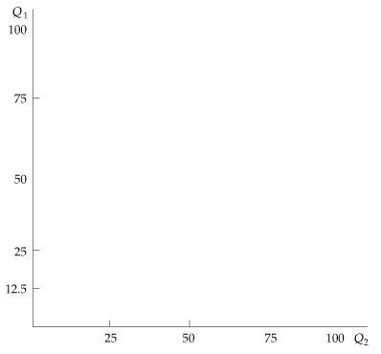
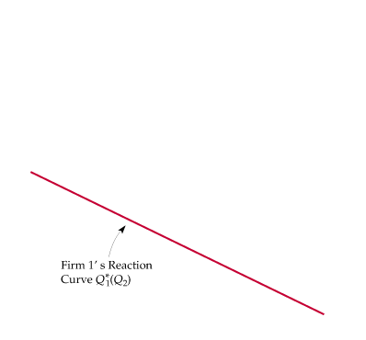
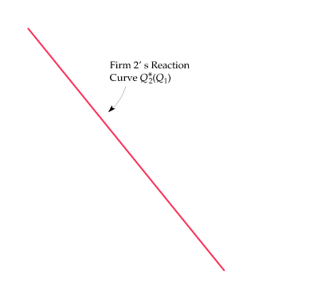
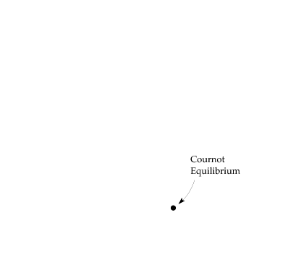
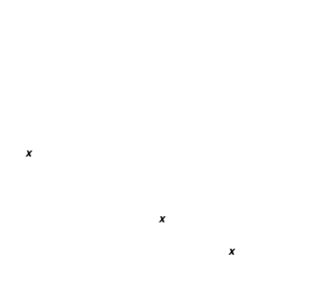
The Cournot Model
Cournot equilibrium: Each firm correctly assumes how much its competitor will produce and sets its own production level accordingly.
Neither firm will move from this equilibrium.

Slide 19
Oligopoly Models
The Stackelberg Model - First Mover Advantage
Oligopoly model in which one firm sets its output before other firms do.
Going first gives a firm an advantage.

Slide 20
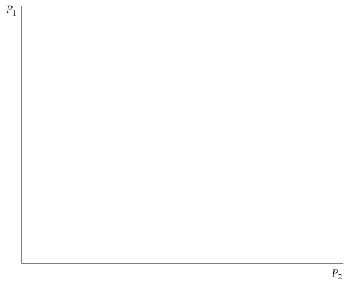
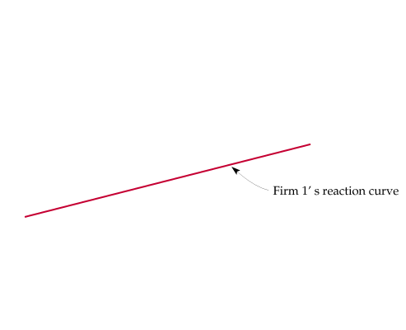
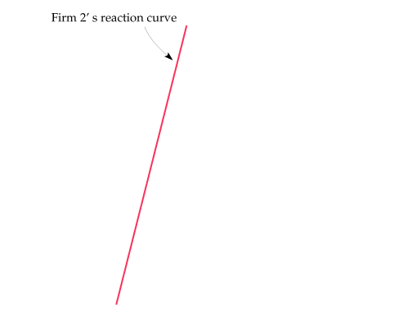
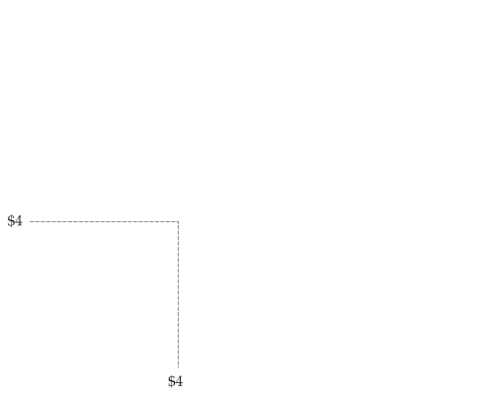
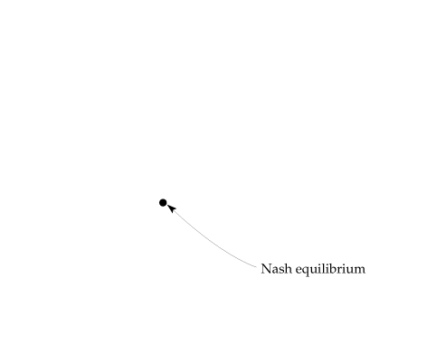
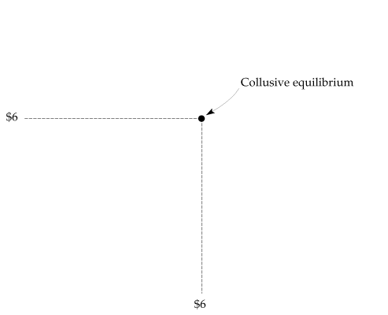
Oligopoly Models Price Competition with Different Products
The reaction curves give profit-maximizing price as a function of the price that the other firm sets.
The Nash equilibrium: When each firm is doing the best it can given its competitor’s price and has no incentive to change price.

Slide 21
Competition versus Collusion
Payoff Matrix for Pricing Game
 |  | Firm 2
 |  | Charge $4 | Charge $6
Firm 1 | Charge $4 | $12, $12 | $20, $4
 | Charge $6 | $4, $20 | $16, $16

Slide 22
Gaming and Strategic Decisions
game Situation in which players (participants) make strategic decisions that take into account each other’s actions and responses.
payoff Value associated with a possible outcome.
strategy Rule or plan of action for playing a game.
optimal strategy Strategy that maximizes a player’s expected payoff.

Slide 23
Gaming and Strategic Decisions
game Situation in which players (participants) make strategic decisions that take into account each other’s actions and responses.
payoff Value associated with a possible outcome.
strategy Rule or plan of action for playing a game.
optimal strategy Strategy that maximizes a player’s expected payoff.

Slide 24

Strategic Decisions
If I believe that my competitors are rational and act to maximize their own payoffs, how should I take their behavior into account when making my decisions?

Slide 25
Cooperative vs. Non-cooperative Games
Cooperative Game
Game in which participants can negotiate binding contracts that allow them to plan joint strategies.
Non-cooperative Game
Game in which negotiation and enforcement of binding contracts are not possible.

Slide 26
Dominant Strategy
Payoff Matrix for Pricing Game
 |  | Pepsi
 |  | Charge $0.5 | Charge $0.75
Coca-Cola | Charge $0.5 | $500 million, $500 million | $900 million, $400 million
 | Charge $0.75 | $400 million, $900 million | $750 million, $750 million
Pepsi’s profits are in blue, and Coca-Cola’s profits are in red.
Firms would collude, but it is against the law.
In this example both firms have a dominant strategy.
Dominant strategy A strategy that is the best for a firm, no matter what strategies other firms use.

Slide 27
Competition versus Collusion: The Prisoners’ Dilemma
The Prisoners’ Dilemma
● prisoners’ dilemma Game theory example in which two prisoners must decide separately whether to confess to a crime; if a prisoner confesses, he will receive a lighter sentence and his accomplice will receive a heavier one, but if neither confesses, sentences will be lighter than if both confess.
Payoff Matrix for Prisoners’ Dilemma
 |  | Prisoner B
 |  | Confess | Don’t confess
Prisoner A | Confess | –5, –5 | –1, –10
 | Don’t confess | –10, –1 | –2, –2

Slide 28
Dominant Strategy
Advertising Game
 |  | Firm B
 |  | Advertise | Don’t Advertise
Firm A | Advertise | 10, 5 | 15, 0
 | Don’t Advertise | 6, 8 | 20, 2

Slide 29
The Nash Equilibrium
Product Choice Problem
 |  | Firm 2
 |  | Crispy | Sweet
Firm 1 | Crispy | -5, -5 | 10, 10
 | Sweet | 10, 10 | -5, -5
Two breakfast cereal companies face a market in which two new variations of cereal can be successfully introduced

Slide 30
Cooperative Equilibrium
In most business situations games are played repeatedly.
Firms can collude implicitly to reach the cooperative equilibrium.
Enforcement mechanisms like price matching
Price leadership

Slide 31
Payoff Matrix in a Repeated Game
Home Depot’s profits per month are in blue, and Lowe’s profits per month are in red.
Payoff Matrix with no offer to match competitors’ price
 |  | Home Depot
 |  | Charge $700 | Charge $800
Lowe’s | Charge $700 | $12,000 / $12,000 | $20,000 / $7,500
 | Charge $800 | $7,500 / $20,000 | $17,000 / $17,000
Payoff Matrix with offer to match competitors’ price
 |  | Home Depot
 |  | Charge $700 | Charge $800
Lowe’s | Charge $700 | $12,000 / $12,000 | $12,000 / $12,000
 | Charge $800 | $12,000 / $12,000 | $17,000 / $17,000

Slide 32
Cartel
Cartel A group of firms that collude by agreeing to restrict output to increase prices and profits.
illegal in the U.S.
Examples:
Are Cartels stable?

Slide 33
Repeated Games
If a game is repeated an infinite number of times, a tit-for-tat strategy might lead to successful cooperation.
If the game is played a known and finite number of times, it could unravel even if players try to signal cooperation.
If the game is played an unknown but finite number of times, it still might be successful to play a tit-for-tat strategy.

Slide 34
Sequential Games and Business Strategy - Deterring Entry
The Decision Tree for an Entry Game
[Assume that the rate of return
owners of fast-food restaurants
must earn to break even is 18%.]
Rates of Return:
Enter
16%_{McD}, 16%_{BK}
Burger King
Large Store
Don’t Enter
25%_{McD}, -- _{BK}
McDonald’s
Small Store
20%_{McD}, 20%_{BK}
Enter
Burger King
Don’t Enter
30%_{McD}, -- _{BK}

Slide 35
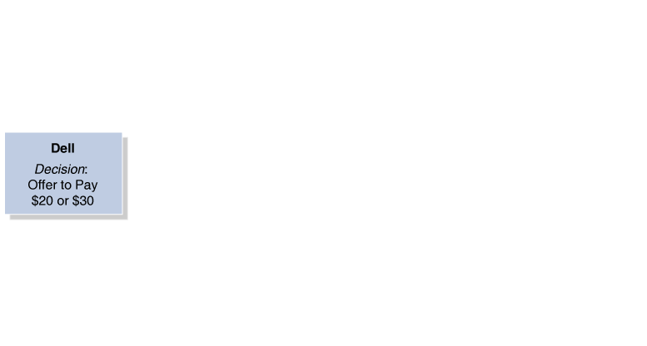
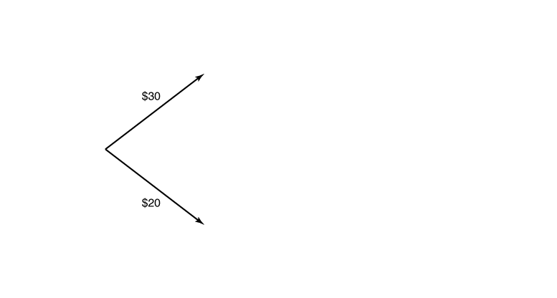
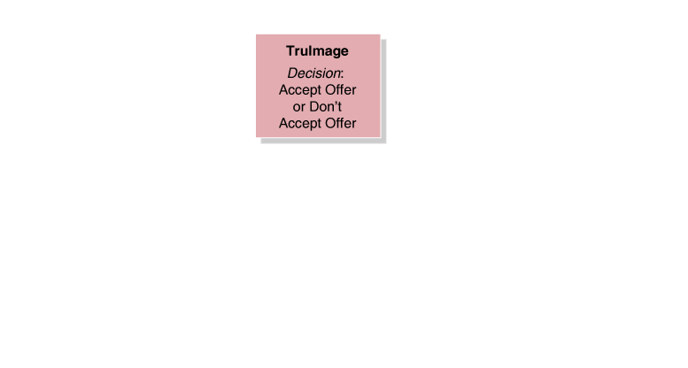
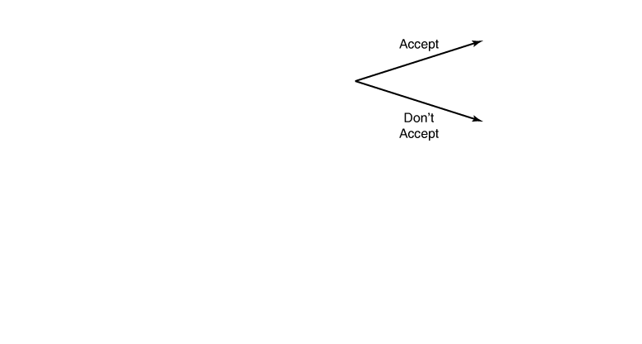
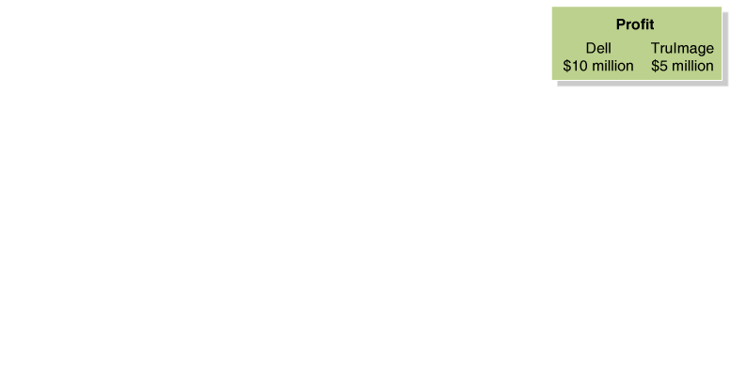
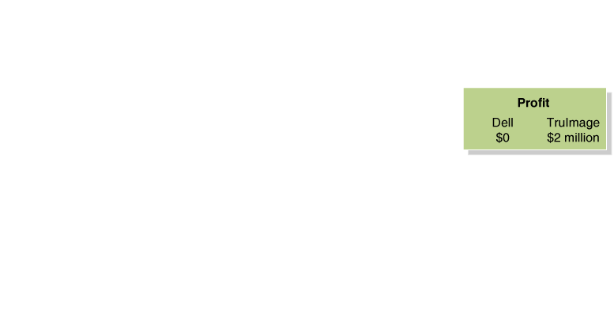
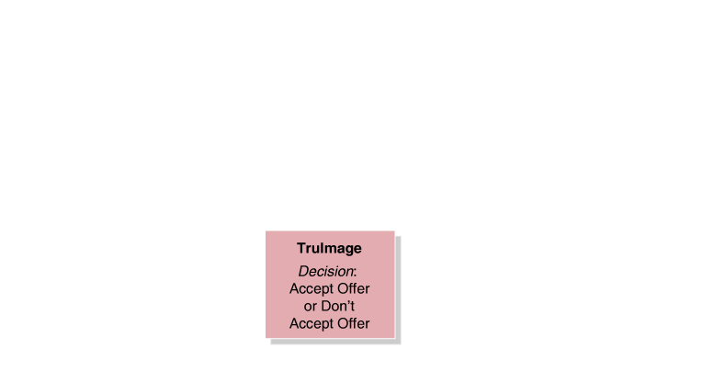
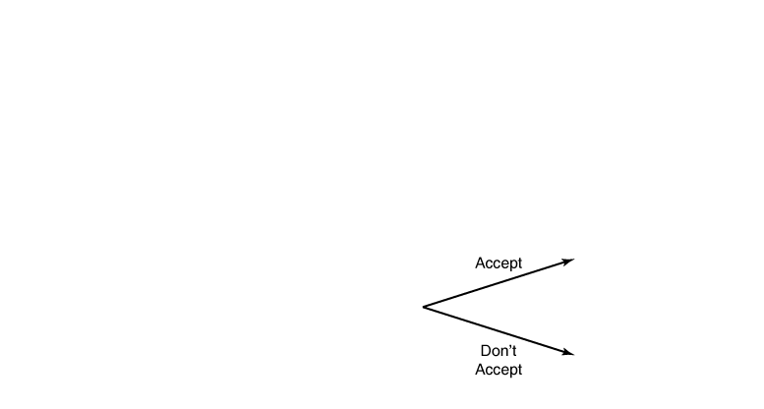
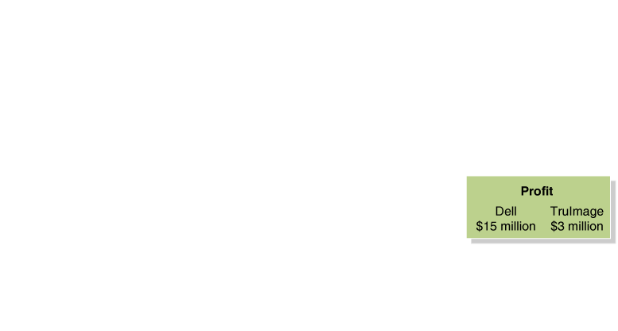
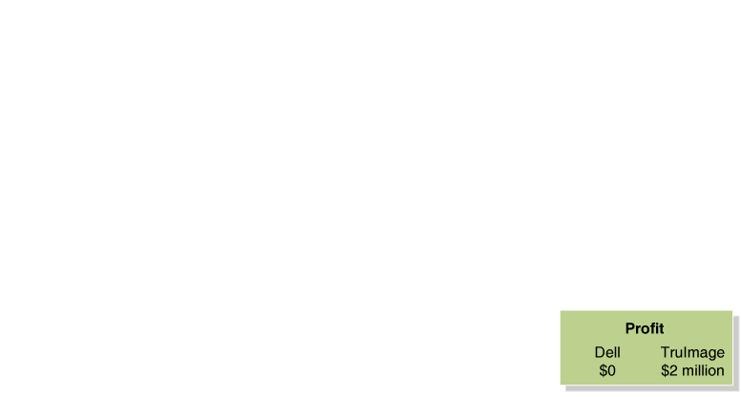
Sequential Games and Business Strategy - Bargaining
The Decision Tree for a Bargaining Game
We have a subgame-perfect equilibrium:
A Nash equilibrium in which no player can make himself or herself better off by changing his decision at any decision node.

